Slide 1
Year 11 Guidance Evening
Core Curriculum Leaders

Slide 2
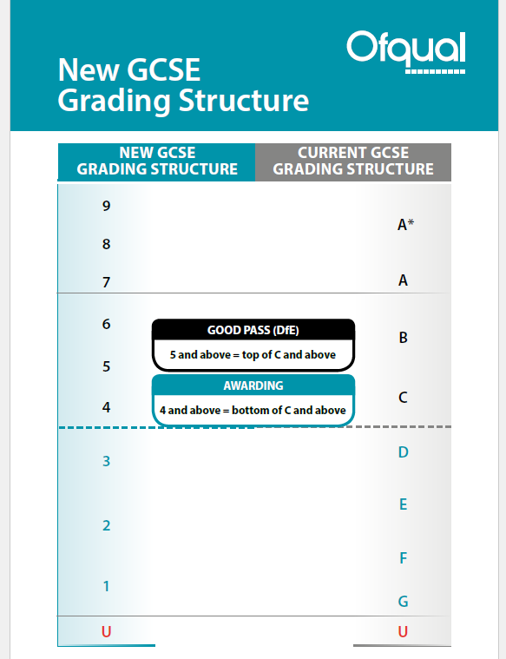
English
Mr McGuire
Head of English
Frequently asked questions:
How are the English GCSE’s different?
What is currently in place for Year 11 English students?
How can I help my child to revise?

Slide 4
Comparison between current specification and the new specification for 2017onwards.
Shift to terminal, closed book exams with no coursework element at all.
Change in grading –9 being the top and 1 the lowest grade.
One tier of entry.
Change in content – pre-19th Century.
English Literature and English Language running alongside each other.

Slide 5
Shift to terminal, closed book exams with no coursework element at all.
What students are doing
What you can do to help
English Paper 2 (non-fiction) being taught currently.
Mock exams. 2nd set of Mocks in February. Language Paper 2 and Literature Paper 1.
Knowing the texts for English Literature and knowing the mark schemes and skills for all papers.
Attending targeted revision sessions.
Attending Intervention sessions.
Encourage students to be revising from an early stage.
Help them to organise their revision. Relevant questions.
Remind students of any Intervention/Revision sessions.
Ask students questions – be involved.
Students CAN revise for English Language.

Slide 6
Papers and dates
Papers and dates
GCSE English Literature
GCSE English Literature
GCSE English Language:
GCSE English Language:
2 exams May 2019.
Wednesday 15th May
Paper 1: Macbeth and A Christmas Carol.
Thursday 23rd May
Paper 2: ‘An Inspector Calls’ and poetry –both studied and unseen.
2 exams May 2019.
Wednesday 15th May
Paper 1: Macbeth and A Christmas Carol.
Thursday 23rd May
Paper 2: ‘An Inspector Calls’ and poetry –both studied and unseen.
2 exams June 2019.
Tuesday 4th June Paper 1:
1 fiction text –unseen.
Narrative/descriptive writing.
Friday 7th June Paper 2:
2 non-fiction texts –unseen from 19th, 20th or 21st centuries.
Writing to argue/persuade.
SPEAKING AND LISTENING (7th May):
Marked separately as a Pass, Merit or Distinction
One presentation and then responding to questions

Slide 7
Revision resources
Exercise books
Mock exams and model answers
Annotated copies of texts
Anthologies
GCSE Pod/SENECA/CenturyTech
AQA website – specimen papers
Tips: All the texts have key characters/themes/messages can they explain them to you?
If students can teach a subject/topic/concept/theme to someone else in a coherent and logical way with evidence to support they will truly have understood the learning.

Slide 8
Maths
Miss Bradley
Head of Maths
Where are we up to?
What’s next?
What can your child be doing?
What resources are available?

Slide 9
Higher Tier v Foundation Tier
Higher Tier – Grades 9 to 4
Foundation Tier – Grades 5 to 1

Slide 10
Where are we up to?
Course nearly completed
Question Level Analysis will be used to inform teaching
Classroom assessment next week – email went home before Christmas – list of topics included to help pupils focus on particular topics
Tier of entry decisions

Slide 11
What’s next?
Full mock (3 papers) will be completed on all content - Paper 1 - Friday 15th February in the Sports Hall during PE time - Paper 2 - Monday 25th & Tuesday 26th February within Maths lessons - Paper 3 - Friday 1st March in the Sports Hall during PE time

Slide 12
What should your child be doing?
Using review sheets to identify areas to target and develop (MathsWatch clips included)
Attending any after school revision offered by their class teachers
Requesting and completing practice papers
KS4 Maths Clinic – Pupils can let Mrs Prior know the day before the topic for specific resources to be provided (every Thursday 1.10- 1.35pm)
Taking any offer of additional support offered by the Maths department
Bringing the correct equipment with them to lessons

Slide 13
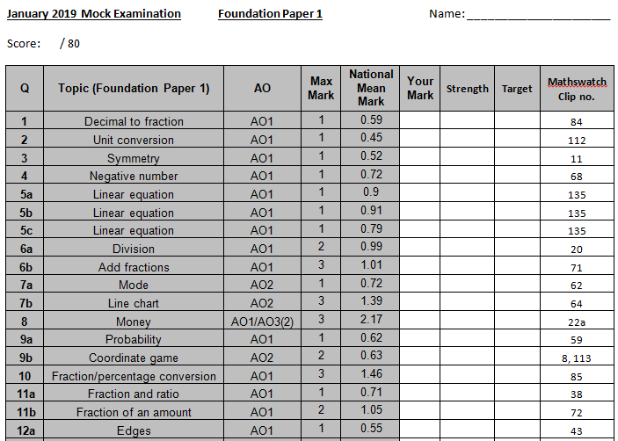
Review sheets – completed after each assessment

Slide 14
What resources can they use?
Mathswatch – videos, printable worksheets and interactive questions
Practice papers – we can send these via email too
Revision guides
GCSE Pod
Justmaths
Corbett Maths
Maths Genie
Kerboodle – online exercise book following the course
Century Tech

Slide 15
After school revision
Miss Wilson’s classes – Monday & Tuesday
Miss Bradley’s class – Tuesday
Miss Veivers’ class – Thursday
Mrs Carey’s class – Thursday
Mr Wormald’s class – Thursday
Mr Middleton’s class – Thursday
(Whole school meetings usually take place on a Wednesday)

Slide 16
How to Revise for Maths
Practise, practise, practise!
Learn important formulae
Tick off topics that are understood

Slide 17
Religious Studies
Mr G. Bowden
Head of Religious Studies

Slide 18
Religious Studies GCSE Specification A:
Full Course overview
Paper 1 – Study of Religion (50%) Catholic Christianity Content: Unit 1. Beliefs and Teachings, Unit 2. Practices, Unit 3. Sources of Wisdom and Authority, Unit 4. Forms of Expression and Ways of Life Assessment: Exam (1 hour 45 mins) 4 Questions - 102 marks
Paper 2 - Second Religion (25%) Judaism Content: Unit 1. Beliefs and Teachings, Unit 2. Practices Assessment: Exam (50 mins) 2 questions - 51 marks
Paper 3 - Philosophy and Ethics (25%) Catholic Christianity Content: Unit 1. Existence of God, Unit 2. Relationships and Families in the 21st century Assessment: Exam (50 mins) 2 questions - 51 marks NB Each question on the whole course has four parts A-D
Notes:
Print off and stick in

Slide 19
The different kinds of questions and how pupils should respond
AO1 50%
AO2 50%
A) Knowledge; asking pupils to give three simple reasons points or beliefs abut a topic (3 Marks)
B) Knowledge and understanding; asking pupils to provide two explained reasons, points or beliefs about a topic (4 marks)
C) Knowledge and understanding; asking pupils to provide two explained reasons, points or beliefs about a topic including a source (quote) to support one reason. (5 Marks)
D) Analysing and evaluating; asking pupils to create a short essay, looking at both sides of an issue, appraising the reasons given for each side and providing a conclusion that gives their justified opinion. (12 marks) (+3 marks SPAG)

Slide 20
Papers and dates
Where pupils are at
GCSE Religious Studies
GCSE English Literature
Paper 3: Completed at the end of Year 9 (Year 9 Exam)
Paper 1: Completed during Year 10 ( Year 10 Mock exam)
Paper 2: Completed at the end of Year 10 and first term of Year 11 (Year 11 mock exam)
Course now completed

Slide 21
Papers and dates
Papers and dates
GCSE Religious Studies
GCSE English Literature
Paper 1 13th May PM (1 Hour 45 mins)
Paper 2 20th May AM (50 mins)
Paper 3 23rd May PM (50 mins)

Slide 22
Papers and dates
Other important dates
GCSE Religious Studies
GCSE English Literature
Paper 3 Unit 1. Existence of God,
Unit 2. Relationships and Families in the 21st century
Practice exam W/b 14th January in class
Paper 1 Unit 1. Beliefs and teachings
Unit 2. Practices.
Practice exam W/b 25th February in class

Slide 23
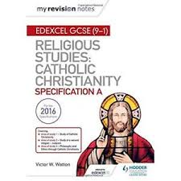
Papers and dates
What Pupils need to do
GCSE Religious Studies
GCSE English Literature
Use Revision guide (available from school) Religious Studies: Catholic Christianity specification A (Victor W Watton) Hodder £7:80
Use notes in exercise books.
Text book with questions available on Kerboodle.
Other resources available on the internet https://qualifications.pearson.com/en/qualifications/edexcel-gcses/religious-studies-a-2016.html#tab-0
Actively revise: Make mind maps, create questions, do practice questions , create presentations, make prompt cards.
Targeted support for underachieving pupils Monday evenings.
ISBN 978-1-210-40480-9

Slide 24
Science
Mr Humphreys
Head of Science

Slide 25
New Science GCSE
Following 1-9 grading method
No more controlled assessment (previously worth 25%)
15% of each exam paper is based on a series of ‘required practicals’ for each respective Science
Foundation or Higher tier entry (max level 5 for F paper)
Triple Science or Combined Science Trilogy
Combined Science Synergy – set 11a5 only
New ‘weighting’ applied to the types of questions

Slide 26
Required Practicals – worth 15%
Combined Science:
7 required practicals in each respective Science
Triple Science:
8 required practicals in each respective Science

Slide 27
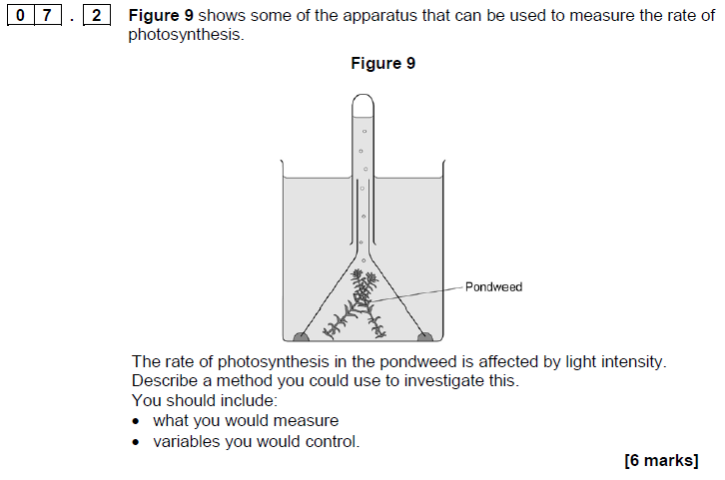
Required Practical – example question

Slide 28
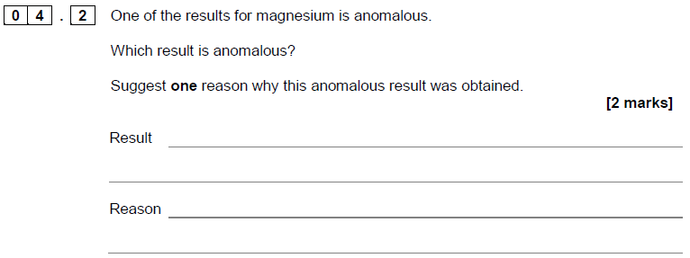
Required Practical – example question

Slide 29
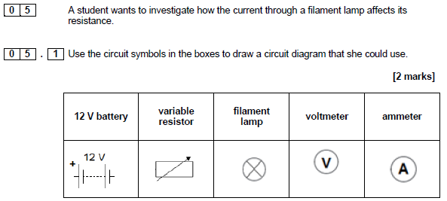
Required Practical – example question

Slide 30
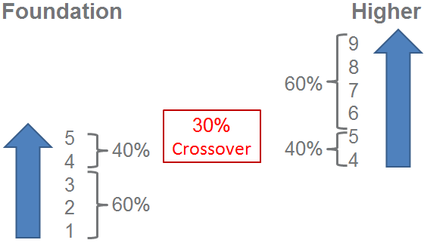
Higher or Foundation Tier
Deadline for entries – 21st April
Second mock exam in March (full paper 2 exam)

Slide 31
Comparing Triple with Combined Science
 | Triple Science | Combined Science
Number of GCSEs awarded | 3 | 2
Number of exams sat | 6 | 6
Time per exam | 1 hr 45 min | 1 hr 15 min
Total topics studied | 26* | 24
* Some additional content within each topic is ‘Triple Science only’

Slide 32
Combined Science Synergy
Small cohort of students following the ‘Synergy’ route.
Students in 11a5
This course combines different elements of Biology, Chemistry and Physics into topics.
‘Building blocks’ covers ‘cells’, ‘sub-atomic particles’ and ‘the particle model of matter’.
There are four exams, each one lasting 1 hr 45 mins.
Question styles include multiple choice, structured, closed and open short answer questions.

Slide 33
How you can support us
Get a revision guide – ISBN numbers on next slide
Help your child to set up a revision timetable (one can be found at https://www.thestudentroom.co.uk/g/planner).
Use sites such as bbc bitesize, the student room, seneca, GCSE pod (download the app on their phone) and CenturyTech (more information this evening) Use CenturyTech – more information this evening
Use YouTube channels, such as ‘myGCSEscience’ (choose AQA as the exam board), ‘doodle science’ (Physics) or ‘Science with Hazel’ (Biology and Chemistry at the moment). Malmesbury science channel is great for revising required practicals.
Encourage your child to attend any support sessions they are invited to.

Slide 34
Revision Guides
CGP Revision Guides:
GCSE Combined Science (Higher) – 978-1782945598
GCSE Combined Science (Foundation) – 978-1782945604
If a student is unsure about their tier of entry they should speak to their teacher before ordering the revision guide
Triple Science | ISBN number
GCSE Biology | 978-1782945567
GCSE Chemistry | 978-1782945574
GCSE Physics | 978-1782945581

Slide 35
Science revision sessions
Biology – Tuesday lunchtime
Chemistry – Thursday lunchtime
Synergy – Wednesday lunchtime
Physics – Friday lunchtime
Sessions start at 1pm
Students may bring a packed lunch, or bring food from the canteen

Slide 36
Examination dates
Biology: Paper 1 – 14th May Paper 2 – 7th June
Chemistry: Paper 1 – 16th May Paper 2 – 12th June
Physics: Paper 1 – 22nd May Paper 2 – 14th June
Synergy Science: Life science: 14th May and 22nd June
Physical science: 7th June and 12th June

